Slide 1
Password checking
Password type: Internet / Network / Wi-Fi

Slide 2
Thing you need:
Update “Microsoft Store”
Download “Terminal” from the new Microsoft Store
Have Permission to run apps as Administrator or type in Administrator account’s password

Slide 3


Type: netsh wlan show profile
Microsoft Windows [Version 10.0.19045.4412]
(c) Microsoft Corporation. All rights reserved.
C:\Users\Holly, Donovan>netsh wlan show profile
Profiles on interface Wi-Fi:
Group policy profiles (read only)
---------------------------------
<None>
User profiles
-------------
All User Profile : SCHOOL NETWORK
C:\Users\Iwwicky>

Slide 4
Type: netsh wlan show profile “network name” key=clear
Tips: After Key Content it is the network password.
Microsoft Windows [Version 10.0.19045.4412]
(c) Microsoft Corporation. All rights reserved.
C:\Users\Holly, Donovan>netsh wlan show profile “SCHOOL NETWORK" key=clear
Profile Amy-5G on interface Wi-Fi:
=======================================================================
Applied: All User Profile
Profile information
-------------------
Version : 1
Type : Wireless LAN
Name : SCHOOL NETWORK
Control options :
Connection mode : Connect automatically
Network broadcast : Connect only if this network is broadcasting
AutoSwitch : Do not switch to other networks
MAC Randomization : Disabled
Connectivity settings
---------------------
Number of SSIDs : 1
SSID name : "Amy-5G"
Network type : Infrastructure
Radio type : [ Any Radio Type ]
Vendor extension : Not present
Security settings
-----------------
Authentication : WPA2-Personal
Cipher : CCMP
Authentication : WPA2-Personal
Cipher : GCMP
Security key : Present
Key Content : Quisp_Elemen_School
Cost settings
-------------
Cost : Unrestricted
Congested : No
Approaching Data Limit : No
Over Data Limit : No
Roaming : No
Cost Source : Default

Slide 5
The 2nd way, Check the current network password

Slide 6
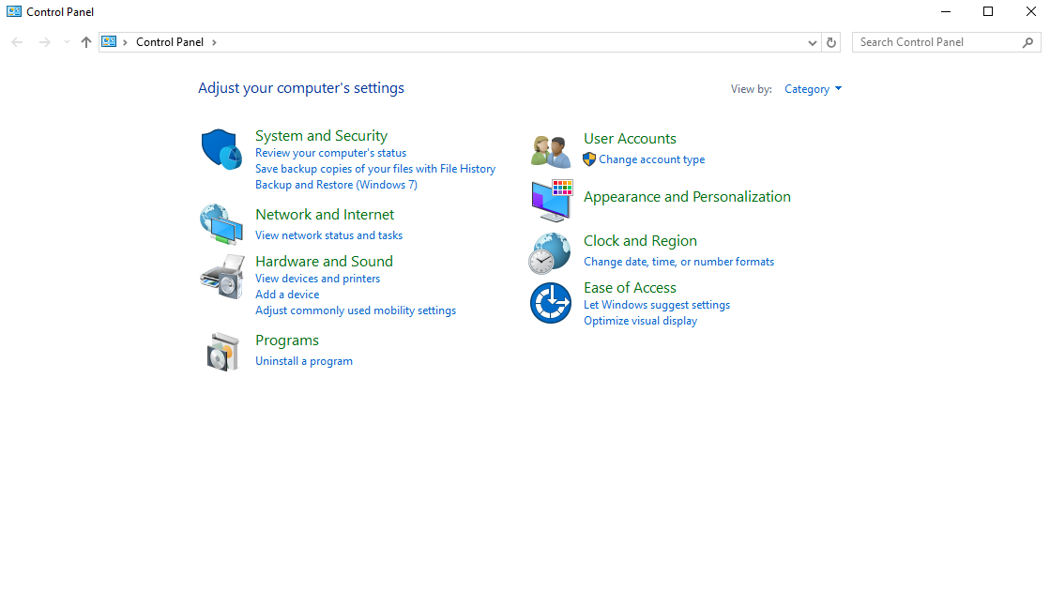

1. Open “Control Pane” and then press the “Network and Internet” button.

Slide 7
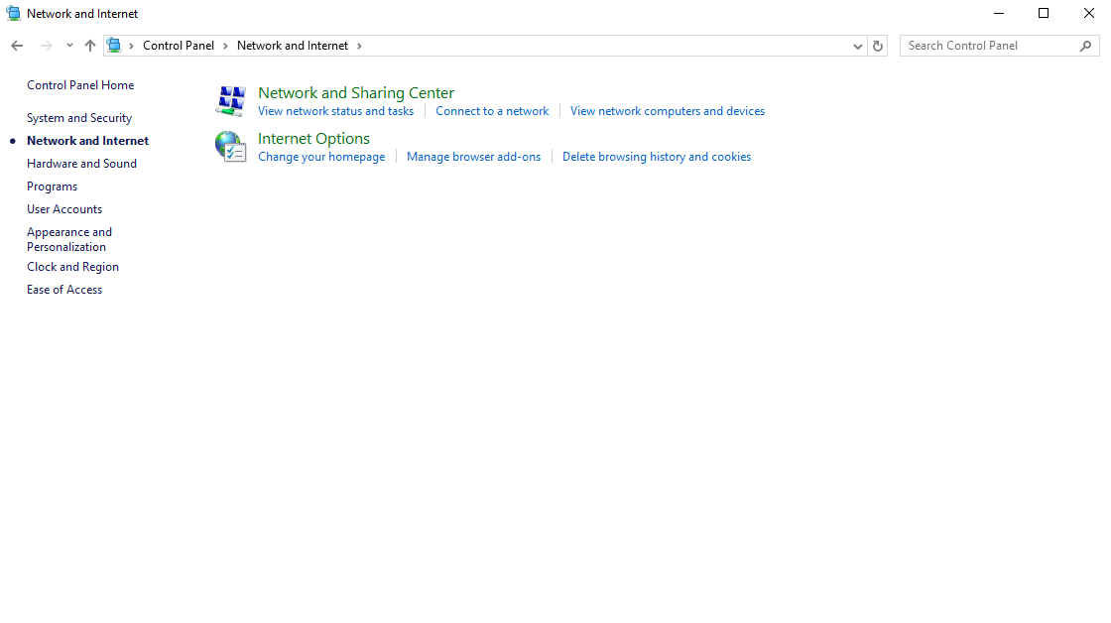

2. Press the “Network and Sharing Center” button.

Slide 8
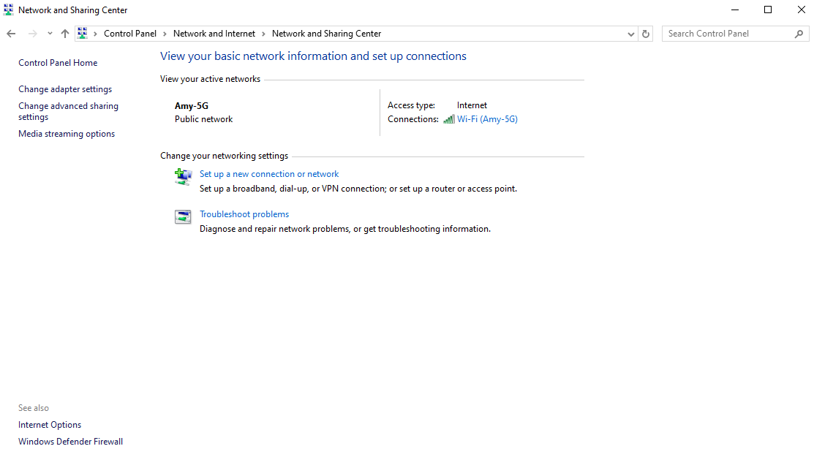

3. Press the Network name beside the Connections.

Slide 9
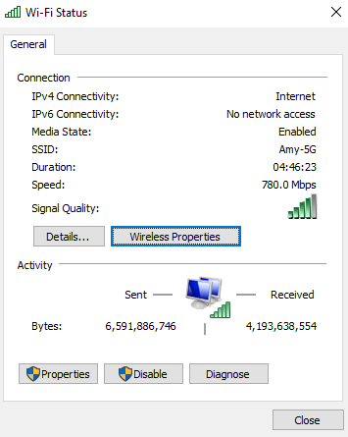





4. Press the “Wireless Properties” button.

Slide 10
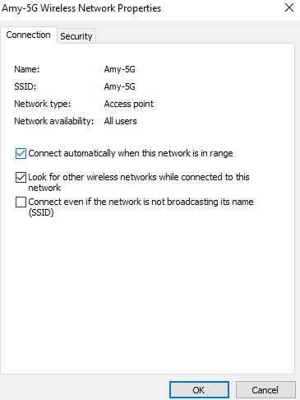

5. Press the “Security” button.

Slide 11
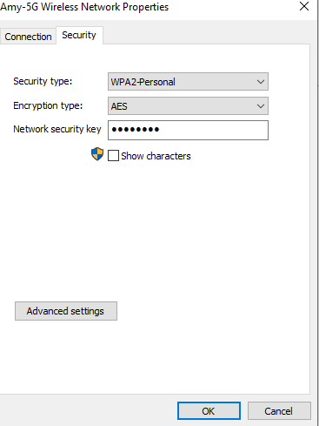
6. When you press the “Show characters” button you wll see the password beside the “Show characters” text, but please notice press the show characters button needs administrative account or type in administrator account’s password.

Slide 12
Thank you for reading!

